Slide 1

Zomato Restaurant Expansion
Created by:
Tanupriya Awasthi
As on 19/07/24

Slide 2

About Zomato
Zomato is an Indian multinational restaurant aggregator and food delivery company. It was founded by Deepinder Goyal and Pankaj Chaddah in 2008.
Zomato charges a 20-25% commission from the particular restaurant for each order placed. In some regions, the commission rate may vary from 5-7%.

Slide 3

Analysis Objective
Identifying the new location where Zomato can open new restaurants and expand its business.
Analyze restaurants ratings and the price range for deeper insights for better decision making .
To analyze and calculate the expenditure so that we can control our expenditure in the newer restaurants.
Analyze the cuisines we should go for in the restaurants.

Slide 4
Data summary of Zomato
Restaurant ID: Unique identifier for each restaurant.
Restaurant Name: The name of the restaurant.
Country Code: Country code of the location where the restaurant is situated.
City: The city where the restaurant is located.
Address: The specific address of the restaurant.
Locality: The locality or neighborhood where the restaurant is situated.
Locality Verbose: Detailed information about the locality.
Longitude: The geographical longitude coordinate of the restaurant.
Latitude: The geographical latitude coordinate of the restaurant.
Cuisines: The type of cuisine offered by the restaurant.
Currency: The currency used for transactions in the restaurant.
Has Table booking: Indicates whether the restaurant has a table booking option (Yes/No).
Has Online delivery: Indicates whether the restaurant offers online delivery (Yes/No).
Is delivering now: Indicates whether the restaurant is currently delivering (Yes/No).
Switch to order menu: Indicates whether users can switch to the order menu (Yes/No).
Price range: A numeric value indicating the price range category of the restaurant.
Votes: The number of votes or ratings/(feedback) received by the restaurant.
Average Cost for two: The average cost for two people dining at the restaurant.
Rating: The overall rating of the restaurant is based on user reviews.
Datekey opening: The date when the restaurant was opened.

Slide 5



Analytical Approach and Tools
Data Cleaning: Utilized function like Clean, remove duplicates to ensure data accuracy.
Data Enrichment: Enhanced the dataset with additional variables using VLOOKUP, Concatenate, IF & AND operators, Find & REPLACE to cross reference external data source.
Descriptive Analysis: Employed pivot tables to for summarizing key metrics and analyzing the expansion for Zomato across different countries and states.
Visualization: Created dynamic charts and dashboards for data representation and enabling interactive data exploration.

Slide 6
No. of restaurants in each country
From the chart we can analyze that in India there are more numbers of restaurants i.e. 7550 we can say that approx 90% market is being occupied by India so the competition is very high there.
In the countries like Canada , Singapore, Sri Lanka and Qatar the market saturation is very low so we suggest to open up for the newer restaurant in these countries as by opening the restaurants we can develop a great market share for the restaurants .

Slide 7
Restaurants opened per year
This charts shows the number of restaurants opened each year.
We can analyze the trend and predict in the next year how many restaurants will open probably. As from 2015 we see a steady growth over the years so we can say the trend will continue.
In 2011 the 979 the highest number of restaurants were opened whereas in 2015 the least number of restaurants were opened.

Slide 8
Average number of Voters
Here we can see the average number of voters in each country.
Indonesia has the highest voters with 772 votes followed by UAE and USA with 494 and 436 votes respectively .
Indonesia has the least number od voters with 20 votes.
Here we can see that India has the large number of restaurants and if we talk about percentage we can that 90% of the total restaurants are opened in India . But here inspite of having the largest market share of restaurants the numbers of voters are quite low .
So we can conclude that even if the country has the higher number of restaurants the voters can vary even though .

Slide 9
Countries where new restaurants can be opened
As we can see in the chart that Canada, Singapore, Qatar, Sri Lanka has least restaurants as compared to other countries so we can open new restaurants here .
Less number of restaurants means we can develop a great market here.
Therefore we should focus on these countries.
We should then look for the cities within these countries where we should focus.
Country | Count of Restaurant
Australia | 24
Brazil | 59
Canada | 4
India | 7550
Indonesia | 21
New Zealand | 40
Philippines | 22
Qatar | 20
Singapore | 20
South Africa | 60
Sri Lanka | 20
Turkey | 34
United Arab Emirates | 60
United Kingdom | 80
United States of America | 419
Grand Total | 8433

Slide 10
States and Cities suggested for opening of new restaurant
In the chart cities are being showed in the suggested countries where newer restaurants can be opened.
These are the particular cities where we can focus for restaurant expansion as the market here is not developed yet .
Less market means less competition that means we can easily develop a market with an average expenditure.

Slide 11
Average ratings in suggested Countries
These are the average ratings in the suggested countries .
The ratings vary between 3.6 to 4.1 on a scale of 5.
Qatar has the highest rating of 4.1 followed by Sri Lanka with a rating of 3.9.
Canada and Singapore has an average rating of 3.6.
The ratings are quite good for these countries so as per the data it can be a good decision if we go for restaurant expansion in these countries.

Slide 12
Price Range Distribution
In this chart we see the price range distribution in the range of 1 to 4.
We see that 42% of restaurant falls under the price range of 1 whereas only 7% of the restaurants falls under the price range of 4.

Slide 13
Table Booking & Online Delivery
Here we can see the two charts which shows the percentage
of the restaurants offering for table booking and online
delivery.
We can see that 29% of the restaurants provides online delivery rest 71% do not offer any online delivery service.
While in the chart 2 we see that only 13% of the restaurants offers for table booking rest 87% do not offer any table booking.
So if in our new restaurants we go for online delivery and table booking then it can be a good strategy .

Slide 14
Average cost for two in each country in INR
Here this charts shows the average cost for two people .
We can see that Singapore has the highest average cost for two people i.e., Rs.9674 followed by UK(Rs.5,176) and Qatar(Rs.5,126)

Slide 15
Top rated Cuisines
Here in the chart we can see the top rated cuisines all over the countries.
We can also see that all the top rated cuisines carry a rating of 4.9.
So we can go for some of these cuisines in our new restaurants as these are highly rated that means mostly preferred by the peoples.

Slide 16
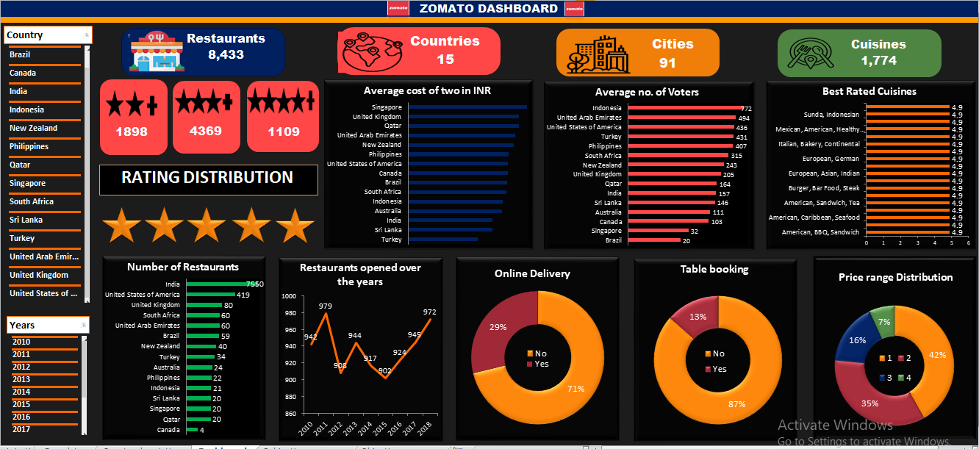
Dashboard and visualization

Slide 17
DashboArd explanation
In our dashboard in the first chart we see the chart which shows the average cost for two people in each country . We can use the country slicer for deeper insight .
In second chart we can see the average number of voters in each country. We can even use slicers to have dynamic look .
In the third chart we can see the best rated cuisines and for deeper insights we can use slicers.
Next we can have the number of restaurants in each country. There we have seen that India has occupied the largest saturation of about 90%. We can use the country slicers to look for the particular country.
In fifth chart we can see the number of restaurants opened over the years . There we have seen that in 2011 least numbers of restaurants were opened and in 2015 the highest number of restaurants were opened . From 2015 we can see a continuous growth over the years . We can use the time slicer as well as the country slicer to have the deeper insights
In next chart we can look for the percentage that are offering for online delivery .
Same way in the second last chart we can look for the percentage of restaurants that offers table booking.
In the last chart doughnut chart we see the restaurants classified in price range from 1 to 4. .
In the dashboard we can also see the various rating distribution like restaurants with 2+ ratings and 3+ as well as 4+ ratings.

Slide 18

Conclusion
Analyzed the data and identified countries where newer restaurants can be opened.
Identified the states and the cities where we can open the restaurant within the suggested country on the basis of the average cost , ratings , no. of restaurants already opened there , price range etc.
All these cities has the highest average cost for two and less market saturation that means less competition.

Slide 19

References
Data provided by the team.
Software used : MS Powerpoint 2010

